Slide 1
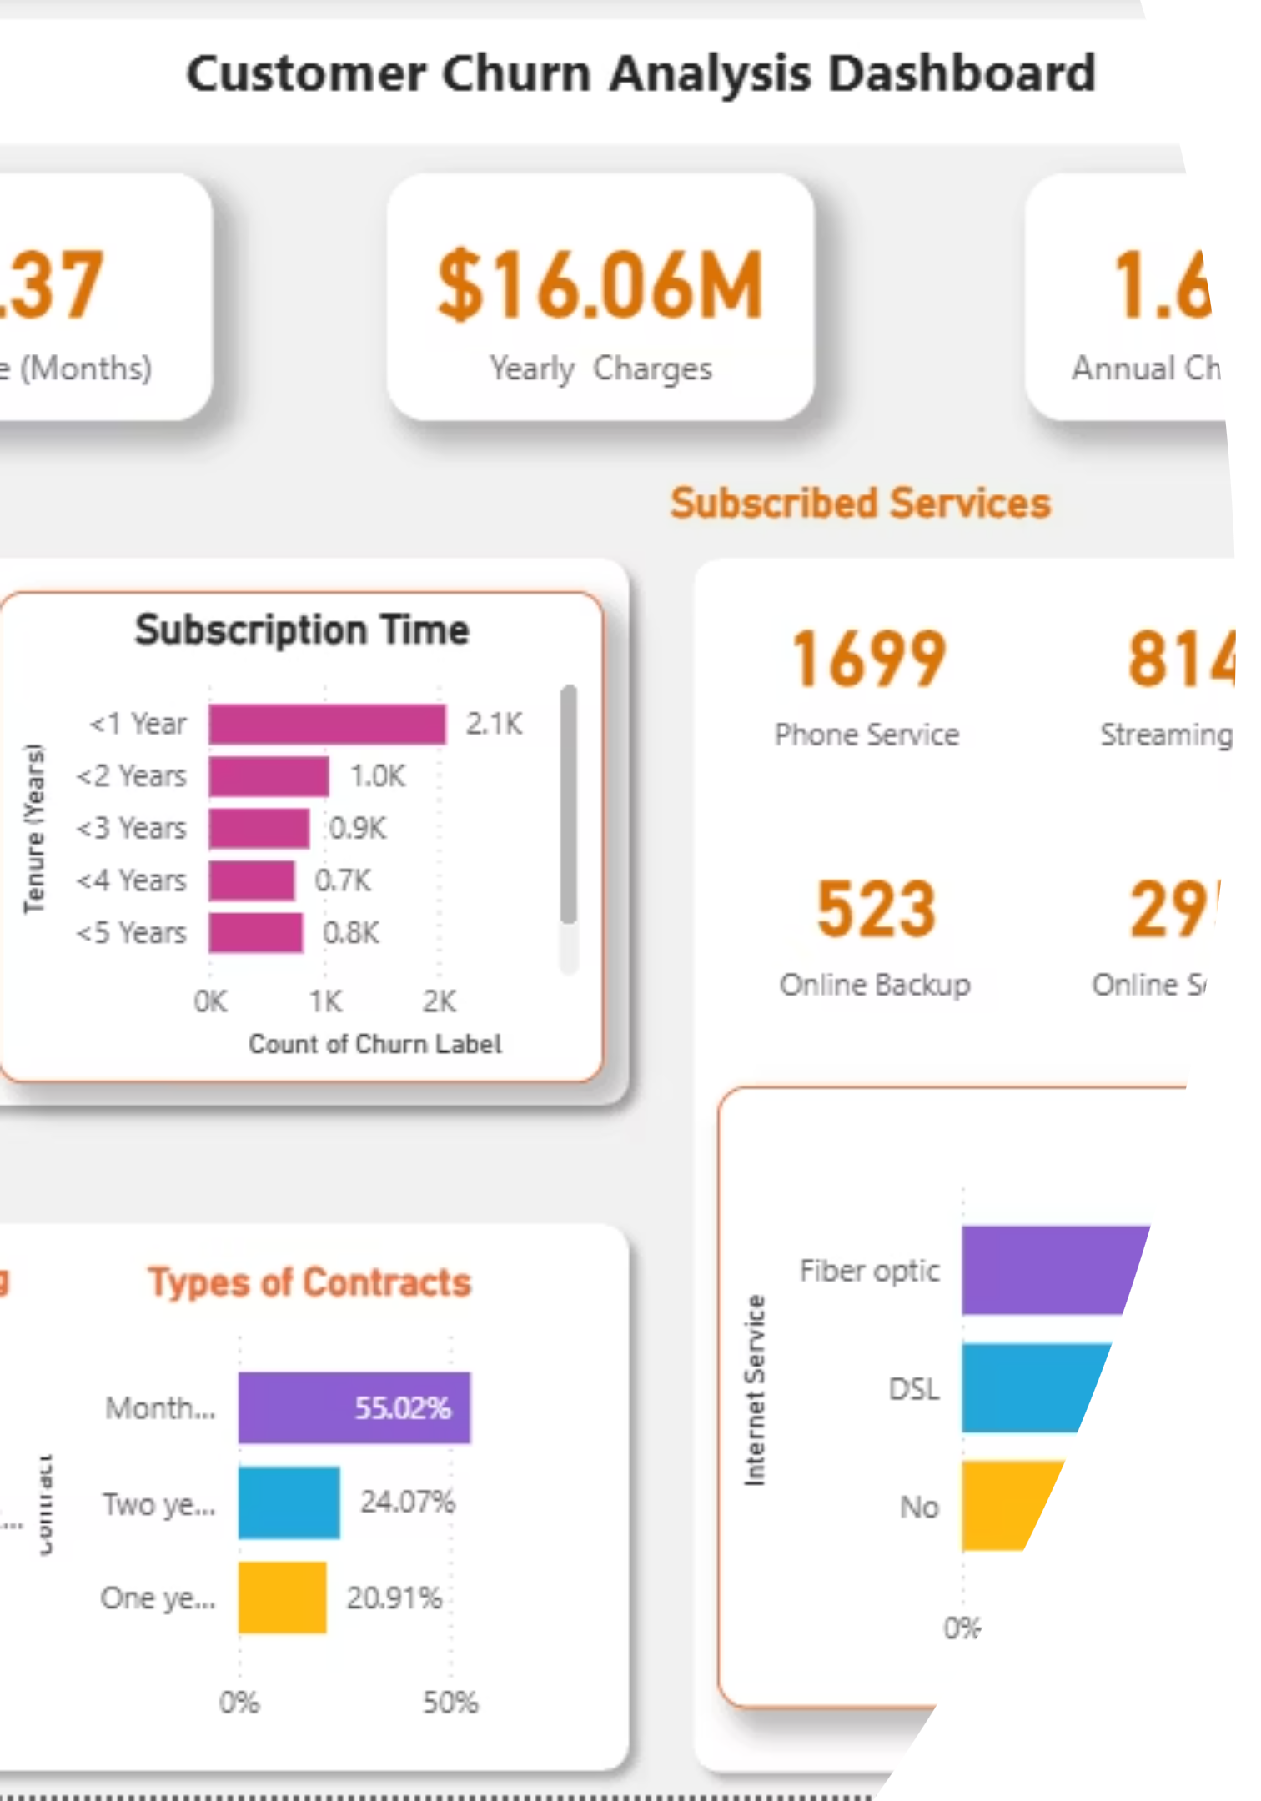
Telco Customer Churn Analysis
Uncovering the key drivers behind customer churn and proposing data-driven retention strategies using Power BI

Slide 2
The Challenge
Customer Churn Crisis
$1.67M
Customer churn is one of the most pressing challenges in the telecom industry, directly impacting revenue and customer lifetime value.
Annual Revenue Lost
This analysis examines the Telco Customer Churn dataset from Kaggle to identify patterns and propose actionable retention strategies.
1,869
Customers at Risk

Slide 3





Dashboard Architecture
Customer Overview
Who is churning and why? Demographics, tenure, payment methods, and contract types.
Deep-Dive Analysis
Services, behaviors, and revenue patterns that influence churn the most.

Slide 4



Tools & Technologies
Power BI Desktop
Power Query
DAX Expressions
Interactive dashboards with advanced visualizations including cards, donut charts, bar charts, and waterfall charts.
Data cleaning and transformation to prepare the Kaggle dataset for analysis.
Custom measures and calculations to derive meaningful business insights.

Slide 5

Critical KPIs
1,869
Total customers at risk of churning
32.37 months
Average customer tenure (~2.7 years)
$16.06M
Total yearly charges
$0.14M
Direct revenue loss from churn

Slide 6

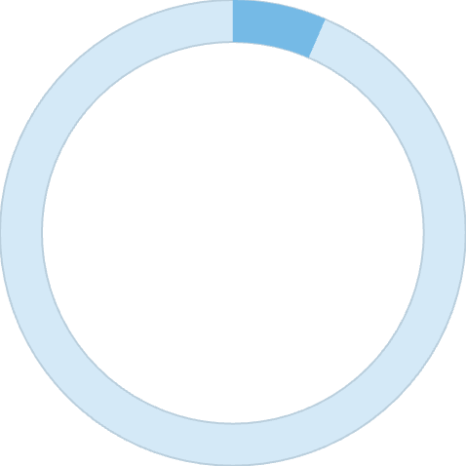
Who's Churning?
High-Risk Demographics
Tenure Insights
Majority of churn happens within the first year. Churn steadily decreases as tenure increases.
Internet Service Type
42%
Fiber Optic: 43.9% churn rate
DSL: 34.3% churn rate
No Internet: 21.6% churn rate
Senior Citizens
Most vulnerable group
6.5%
With Dependents
Family plans reduce churn
Contract & Payment Patterns
55% churn from month-to-month contracts
33.6% use electronic checks (highest risk)
59% have paperless billing

Slide 7
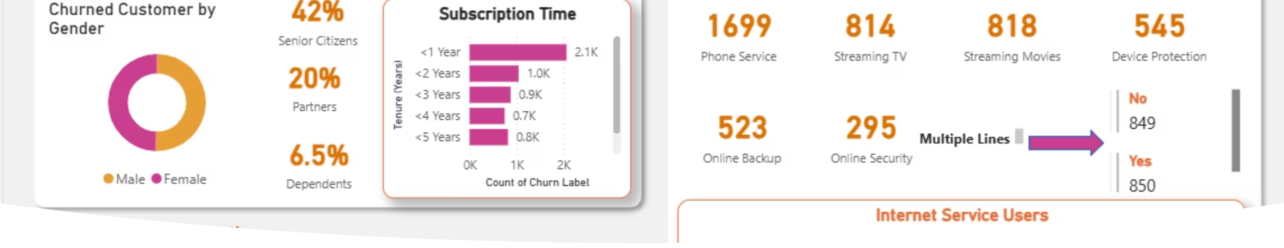
Customer Overview Dashboard
01
02
Early Churn Crisis
Senior Citizen Risk
Most customers leave within the first year
42% of churned customers are seniors
03
04
Payment Method Impact
Contract Commitment
Electronic check users dominate churn
Month-to-month contracts show 55% churn

Slide 8
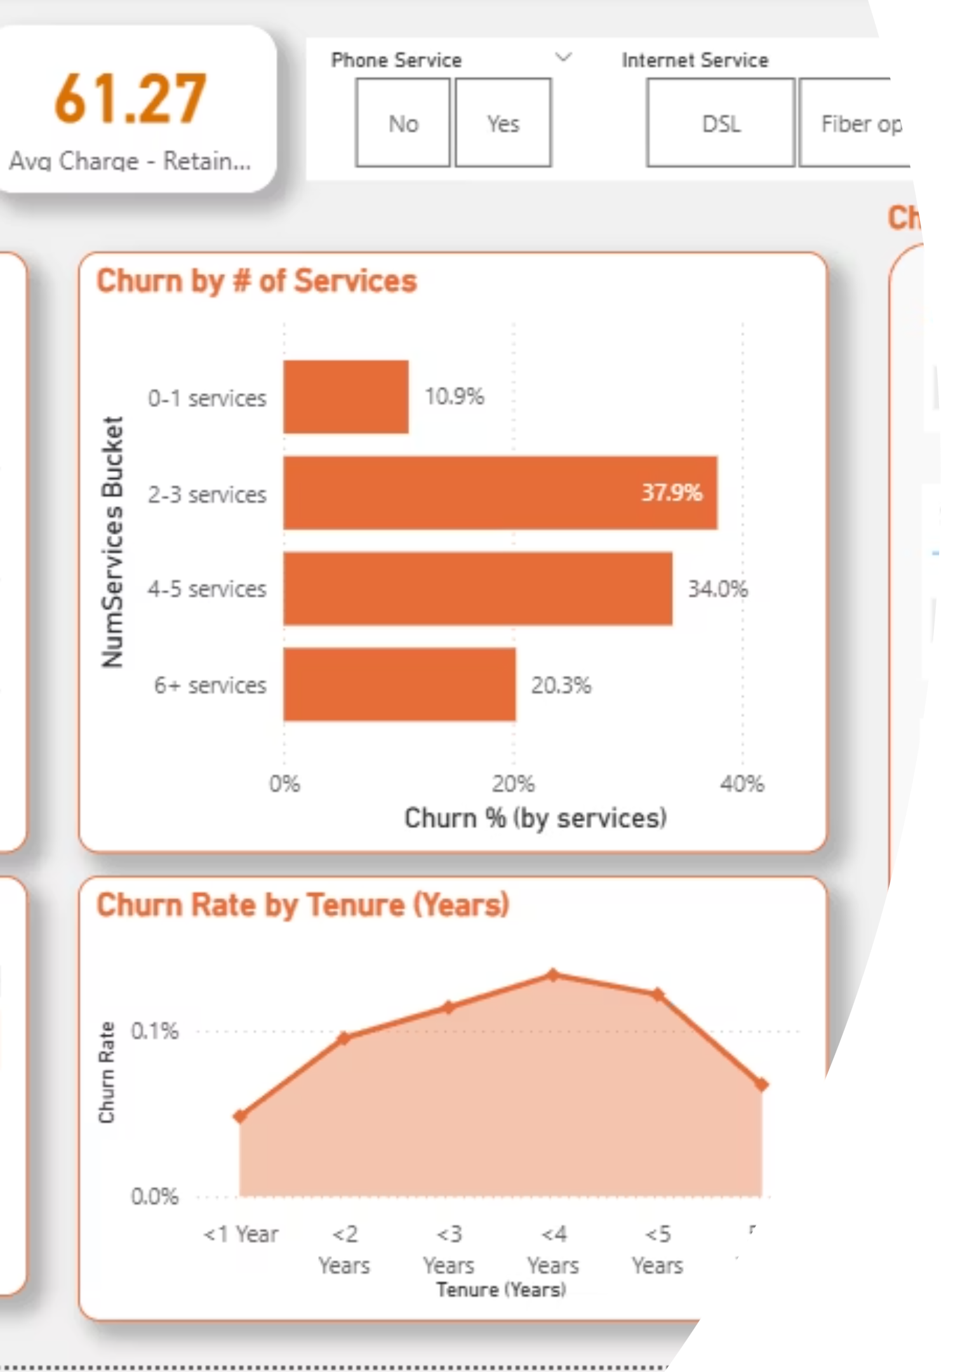
Deep-Dive Insights
Service Engagement
Revenue & Risk Patterns
Customers with 2-3 services (38%) churn the most, while those with 6+ services (20%) show highest retention.
Electronic check causes largest revenue loss (~$84K). Churn peaks around 2-3 years tenure.
Customers without Online Security or Backup churn more frequently.
Medium-risk customers represent the highest churn count—an overlooked retention opportunity.

Slide 9
Strategic Recommendations
1
Enhance Onboarding
Create loyalty programs for customers in their first 6-12 months with personalized engagement.
2
Target Senior Citizens
Offer simplified plans and priority support for the most vulnerable demographic.
3
Payment Incentives
Encourage auto-pay and secure digital payments instead of electronic checks.
4
Contract Optimization
Provide discounts for customers switching from month-to-month to yearly contracts.
5
Cross-Sell Add-Ons
Bundle Online Security and Backup services to improve retention and engagement.
6
Mid-Term Engagement
Focus on 2-3 year customers with renewal rewards and personalized upgrade offers.

Slide 10

Conclusion & Impact
The Telco Customer Churn Dashboard reveals that contract type, tenure, payment method, and service engagement are the strongest predictors of churn.
By implementing targeted strategies based on these insights, telecom companies can significantly reduce churn and protect an estimated $1.67M in annual revenue.
Author: Bhawna Kumari
Data Analyst | bhawnak0313@gmail.com
LinkedIn | GitHub

